Slide 1


Контроль качества осветительных приборов.
Испытательные центры.
Беляев Р.И.
Главный метролог ООО «ВНИСИ»
1

Slide 2




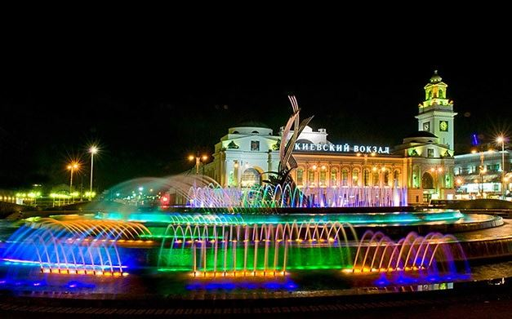


Приоритет в освещении – качество и надежность
Гонка за энергоэффективностью не должна идти в ущерб качеству светотехнической продукции.
2
Notes:
2

Slide 3

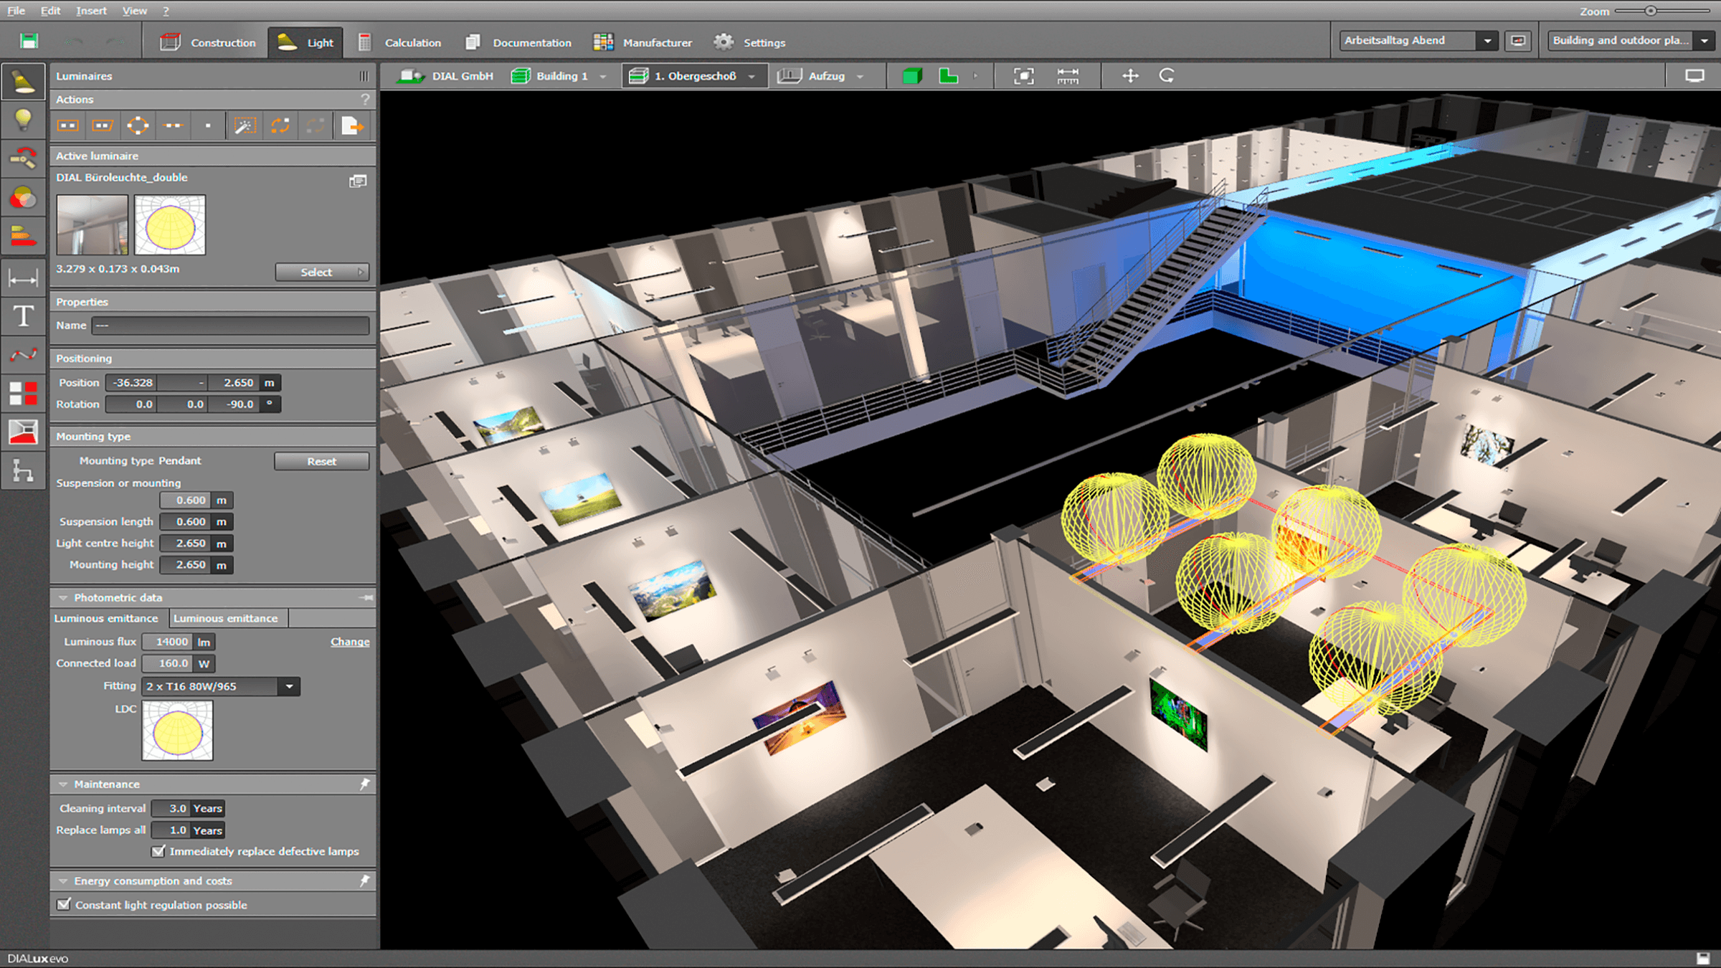
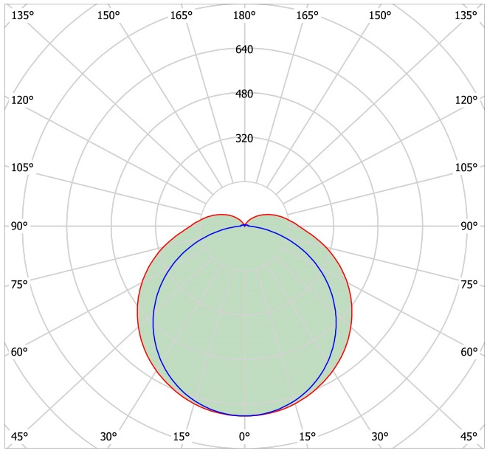
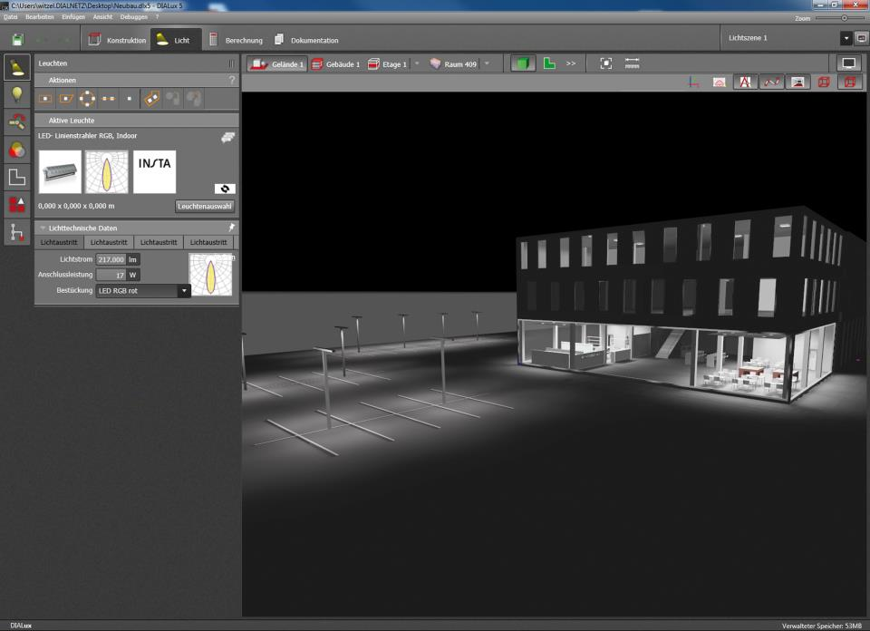
Ошибки при расчётах ведут к ошибкам при реализации
Выбор качественного осветительного прибора на стадии проектирования осветительной установки позволяет обеспечить корректные данные по нормируемым параметрам при реализации проекта.
Использование файлов фотометрических данных при проектировании
Измеренная КСС в лаборатории
3
Notes:
3

Slide 4



Ответ на главный вопрос
Часто задаваемый вопрос – какой же осветительный прибор можно назвать качественным?
4
Notes:
4
There were no participants from USA (only two from Americas region) because National Voluntary Laboratory Accreditation Program (NVLAP) has already provided an accreditation programme4 for SSL testing since 2009, for which NIST provides PT, and also NIST provides PT service for SSL testing under NIST Measurement Assurance Program (MAP) for accreditation bodies other than NVLAP.
After the IC was launched, Asia Pacific Laboratory Accreditation Cooperation (APLAC) launched a similar PT program (APLAC Proficiency Test T088) conducted in 2013. This programme was operated by NLTC using the same test method (i.e., the Interlaboratory Comparison Test Method 1.0 [5]) and the same artefact types used in IC 2013. For all of these reasons, it was agreed that the results of this APLAC PT programme could be linked to IC 2013, and laboratories registering for T088 were given the option of having their results linked to IC 2013. Twenty-one laboratories chose to be linked to IC 2013

Slide 5
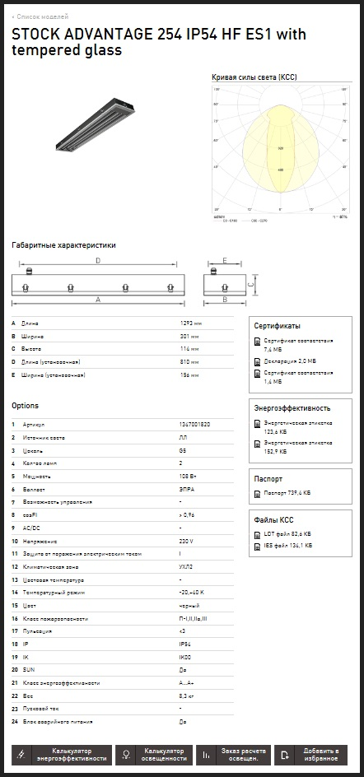
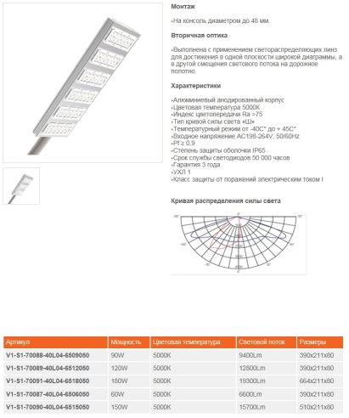
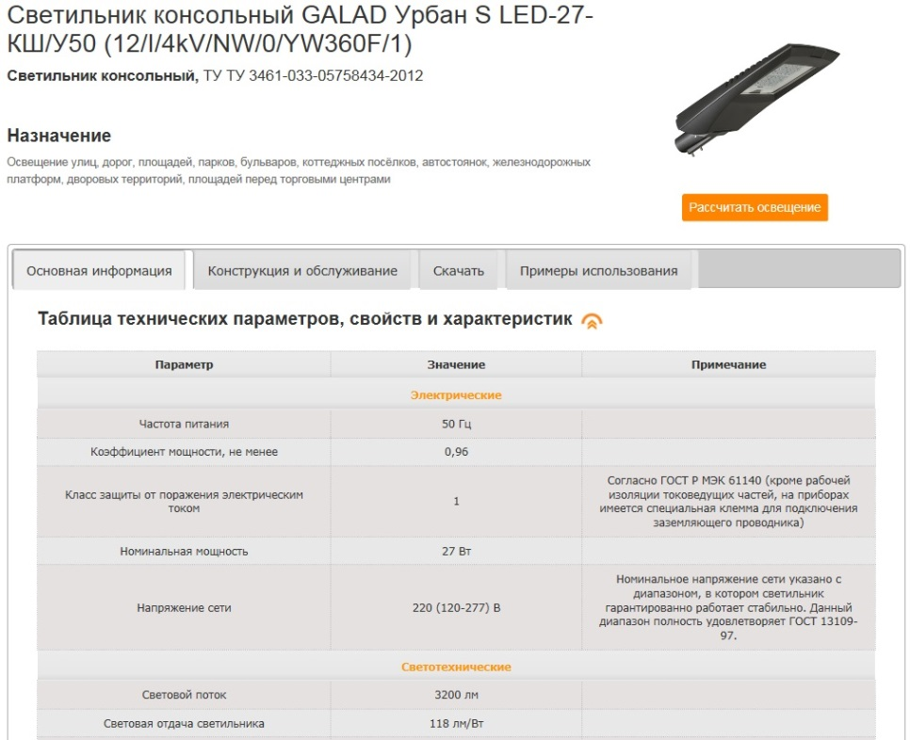
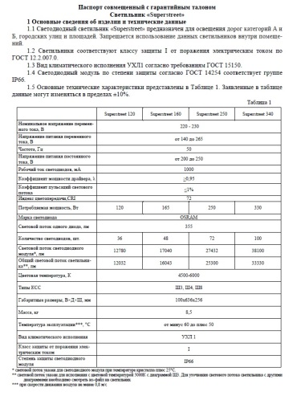
Качество = соответствие техническим характеристикам
Показатель качества продукции (согласно ГОСТ 15467) – количественная характеристика одного или нескольких свойств продукции, входящих в ее качество, рассматриваемая применительно к определенным условиям ее создания и эксплуатации или потребления.
5
Notes:
5
There were no participants from USA (only two from Americas region) because National Voluntary Laboratory Accreditation Program (NVLAP) has already provided an accreditation programme4 for SSL testing since 2009, for which NIST provides PT, and also NIST provides PT service for SSL testing under NIST Measurement Assurance Program (MAP) for accreditation bodies other than NVLAP.
After the IC was launched, Asia Pacific Laboratory Accreditation Cooperation (APLAC) launched a similar PT program (APLAC Proficiency Test T088) conducted in 2013. This programme was operated by NLTC using the same test method (i.e., the Interlaboratory Comparison Test Method 1.0 [5]) and the same artefact types used in IC 2013. For all of these reasons, it was agreed that the results of this APLAC PT programme could be linked to IC 2013, and laboratories registering for T088 were given the option of having their results linked to IC 2013. Twenty-one laboratories chose to be linked to IC 2013

Slide 6
Характеристики, определяющие качество осветительного прибора
Фотометрические и электрические характеристики
Для приборов внутреннего освещения:
тип КСС и класс светораспределения
защитный угол
световой поток прибора
спад светового потока ОП с момента включения
до выхода на стабильный режим работы (для СД приборов)
КПД (для приборов с лампами)
габаритная яркость
световая отдача
коэффициент пульсации
коррелированная цветовая температура
индекс цветопередачи
потребляемая мощность
коэффициент мощности
Для приборов наружного освещения:
тип КСС и класс светораспределения
тип светораспределения в зоне слепимости
световой поток прибора
спад светового потока ОП с момента включения
до выхода на стабильный режим работы (для СД приборов)
КПД (для приборов с лампами)
световая отдача
потребляемая мощность
коэффициент мощности
6
Notes:
6
There were no participants from USA (only two from Americas region) because National Voluntary Laboratory Accreditation Program (NVLAP) has already provided an accreditation programme4 for SSL testing since 2009, for which NIST provides PT, and also NIST provides PT service for SSL testing under NIST Measurement Assurance Program (MAP) for accreditation bodies other than NVLAP.
After the IC was launched, Asia Pacific Laboratory Accreditation Cooperation (APLAC) launched a similar PT program (APLAC Proficiency Test T088) conducted in 2013. This programme was operated by NLTC using the same test method (i.e., the Interlaboratory Comparison Test Method 1.0 [5]) and the same artefact types used in IC 2013. For all of these reasons, it was agreed that the results of this APLAC PT programme could be linked to IC 2013, and laboratories registering for T088 were given the option of having their results linked to IC 2013. Twenty-one laboratories chose to be linked to IC 2013

Slide 7
Характеристики, определяющие качество осветительного прибора
Характеристики безопасности
Для всех осветительных приборов, независимо от области применения:
соответствие ТР ТС 004/2011 о безопасности низковольтного оборудования
соответствие ТР ТС 020/2011 электромагнитная совместимость технических средств
7
Notes:
7
There were no participants from USA (only two from Americas region) because National Voluntary Laboratory Accreditation Program (NVLAP) has already provided an accreditation programme4 for SSL testing since 2009, for which NIST provides PT, and also NIST provides PT service for SSL testing under NIST Measurement Assurance Program (MAP) for accreditation bodies other than NVLAP.
After the IC was launched, Asia Pacific Laboratory Accreditation Cooperation (APLAC) launched a similar PT program (APLAC Proficiency Test T088) conducted in 2013. This programme was operated by NLTC using the same test method (i.e., the Interlaboratory Comparison Test Method 1.0 [5]) and the same artefact types used in IC 2013. For all of these reasons, it was agreed that the results of this APLAC PT programme could be linked to IC 2013, and laboratories registering for T088 were given the option of having their results linked to IC 2013. Twenty-one laboratories chose to be linked to IC 2013

Slide 8
Характеристики, определяющие качество осветительного прибора
Характеристики защиты корпуса осветительного прибора от воздействия окружающей среды
пыле и влагозащита (IP)
диапазон рабочих температур окружающей среды (климатическое исполнение)
степень защиты от прямых механических ударов (код IK)
группа механического исполнения (группы Мхх)
8
Notes:
8
There were no participants from USA (only two from Americas region) because National Voluntary Laboratory Accreditation Program (NVLAP) has already provided an accreditation programme4 for SSL testing since 2009, for which NIST provides PT, and also NIST provides PT service for SSL testing under NIST Measurement Assurance Program (MAP) for accreditation bodies other than NVLAP.
After the IC was launched, Asia Pacific Laboratory Accreditation Cooperation (APLAC) launched a similar PT program (APLAC Proficiency Test T088) conducted in 2013. This programme was operated by NLTC using the same test method (i.e., the Interlaboratory Comparison Test Method 1.0 [5]) and the same artefact types used in IC 2013. For all of these reasons, it was agreed that the results of this APLAC PT programme could be linked to IC 2013, and laboratories registering for T088 were given the option of having their results linked to IC 2013. Twenty-one laboratories chose to be linked to IC 2013

Slide 9
Статистика несоответствия
Несоответствие характеристикам или отрицательные результаты испытаний ИЦ ВНИСИ за 2016 г.
Светотехнические и электрические характеристики – 55%
Характеристики безопасности – 10 %
Характеристики защиты корпуса осветительного прибора от воздействия окружающей среды – 75%
9
Notes:
9
There were no participants from USA (only two from Americas region) because National Voluntary Laboratory Accreditation Program (NVLAP) has already provided an accreditation programme4 for SSL testing since 2009, for which NIST provides PT, and also NIST provides PT service for SSL testing under NIST Measurement Assurance Program (MAP) for accreditation bodies other than NVLAP.
After the IC was launched, Asia Pacific Laboratory Accreditation Cooperation (APLAC) launched a similar PT program (APLAC Proficiency Test T088) conducted in 2013. This programme was operated by NLTC using the same test method (i.e., the Interlaboratory Comparison Test Method 1.0 [5]) and the same artefact types used in IC 2013. For all of these reasons, it was agreed that the results of this APLAC PT programme could be linked to IC 2013, and laboratories registering for T088 were given the option of having their results linked to IC 2013. Twenty-one laboratories chose to be linked to IC 2013

Slide 10
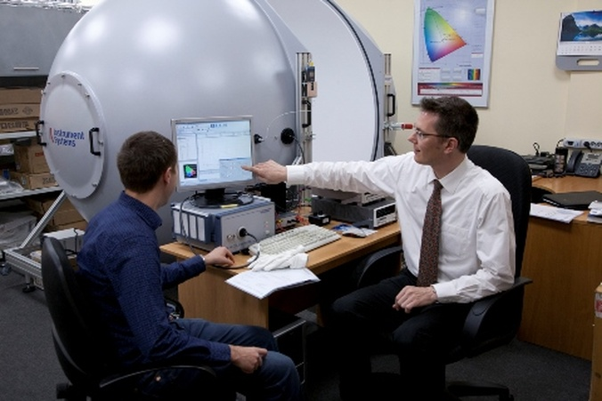
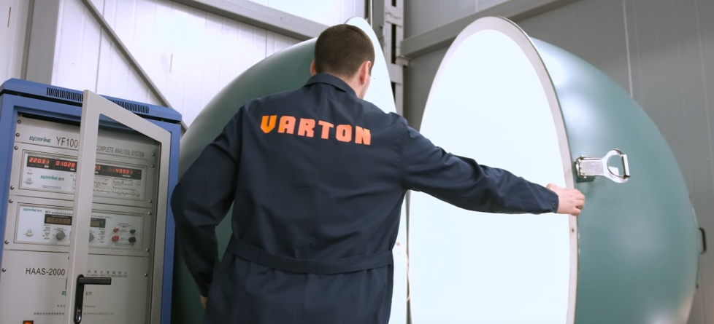


Проверка продукции на соответствие
Соответствие техническим характеристикам должно проверяется производителем на стадии производства продукции.
Внедрение систем контроля качества на производстве (ОТК) и стандартов серии ISO 9000, позволяет производителю повысить качество выпускаемых осветительных приборов
Производственная лаборатория МГК «Световые Технологии»
Технологические процессы на производстве холдинга БЛ ГРУПП (GALAD) и АО «Физтех-Энерго» (Diora) с соблюдением стандартов серии ISO 9000
Производственная лаборатория ООО ТПК «ВАРТОН»
10
Notes:
10
There were no participants from USA (only two from Americas region) because National Voluntary Laboratory Accreditation Program (NVLAP) has already provided an accreditation programme4 for SSL testing since 2009, for which NIST provides PT, and also NIST provides PT service for SSL testing under NIST Measurement Assurance Program (MAP) for accreditation bodies other than NVLAP.
After the IC was launched, Asia Pacific Laboratory Accreditation Cooperation (APLAC) launched a similar PT program (APLAC Proficiency Test T088) conducted in 2013. This programme was operated by NLTC using the same test method (i.e., the Interlaboratory Comparison Test Method 1.0 [5]) and the same artefact types used in IC 2013. For all of these reasons, it was agreed that the results of this APLAC PT programme could be linked to IC 2013, and laboratories registering for T088 were given the option of having their results linked to IC 2013. Twenty-one laboratories chose to be linked to IC 2013

Slide 11
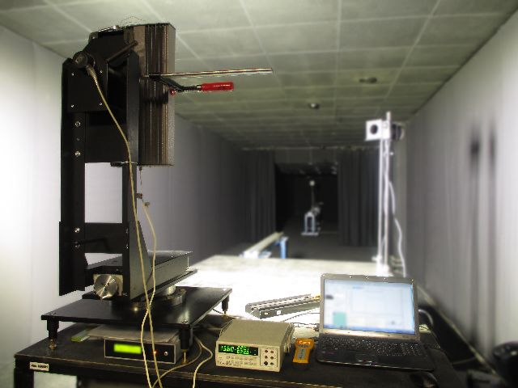
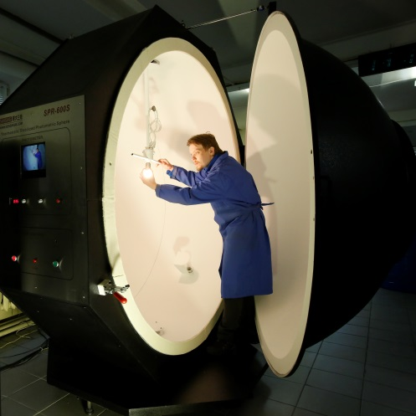
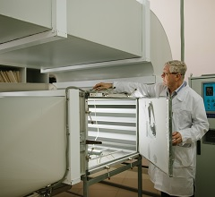
Проверка продукции на соответствие
Независимые аккредитованные испытательные центры и лаборатории проверяют качество осветительных приборов на соответствие заявленным техническим характеристикам и требованиям актуальных стандартов
Лаборатории, подтвердившие свою компетентность и независимость, и пользующиеся доверием со стороны потребителей и производителей осветительного оборудования:
ООО «Александровский испытательный центр»
ООО «НТЦ «Фотометрия»
ИЦ ООО ВНИСИ
НИИИС имени А.Н.Лодыгина
ФГУП ВНИИОФИ
ФБУ «Ростест-Москва»
11
Notes:
11
There were no participants from USA (only two from Americas region) because National Voluntary Laboratory Accreditation Program (NVLAP) has already provided an accreditation programme4 for SSL testing since 2009, for which NIST provides PT, and also NIST provides PT service for SSL testing under NIST Measurement Assurance Program (MAP) for accreditation bodies other than NVLAP.
After the IC was launched, Asia Pacific Laboratory Accreditation Cooperation (APLAC) launched a similar PT program (APLAC Proficiency Test T088) conducted in 2013. This programme was operated by NLTC using the same test method (i.e., the Interlaboratory Comparison Test Method 1.0 [5]) and the same artefact types used in IC 2013. For all of these reasons, it was agreed that the results of this APLAC PT programme could be linked to IC 2013, and laboratories registering for T088 were given the option of having their results linked to IC 2013. Twenty-one laboratories chose to be linked to IC 2013

Slide 12
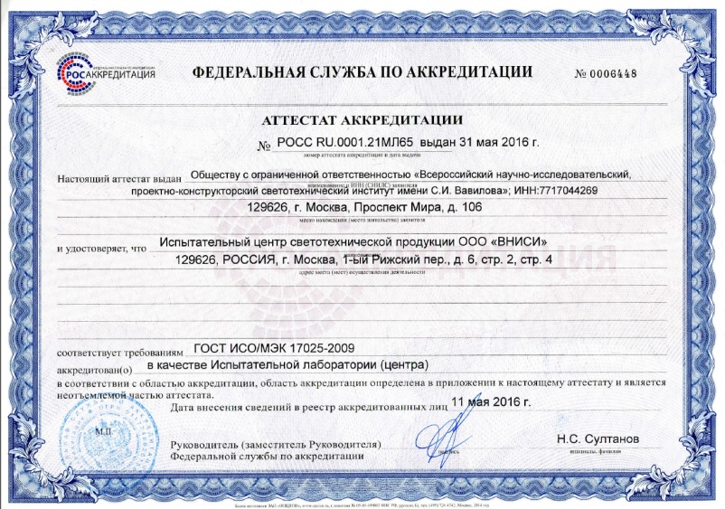
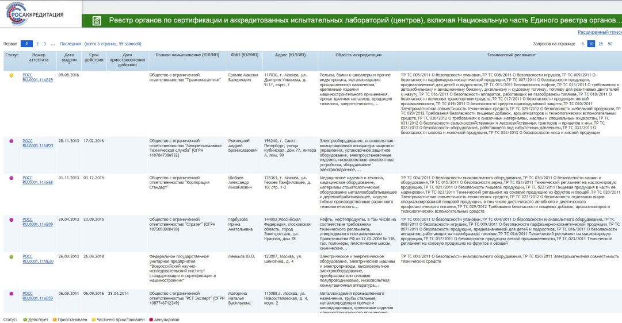
Аккредитация как критерий выбора лаборатории
Компетентность и независимость ИЦ ВНИСИ при проведении испытаний светотехнической продукции подтверждена аттестатом аккредитации
РОСС RU.0001.21МЛ65
Про аккредитацию лабораторий и центров можно узнать из Реестра аккредитованных лиц на сайте федеральной службы по аккредитации - Росаккредитация
С 2014 года с рынка услуг ушли 2712 органов по сертификации и 730 лабораторий
12
Notes:
12
There were no participants from USA (only two from Americas region) because National Voluntary Laboratory Accreditation Program (NVLAP) has already provided an accreditation programme4 for SSL testing since 2009, for which NIST provides PT, and also NIST provides PT service for SSL testing under NIST Measurement Assurance Program (MAP) for accreditation bodies other than NVLAP.
After the IC was launched, Asia Pacific Laboratory Accreditation Cooperation (APLAC) launched a similar PT program (APLAC Proficiency Test T088) conducted in 2013. This programme was operated by NLTC using the same test method (i.e., the Interlaboratory Comparison Test Method 1.0 [5]) and the same artefact types used in IC 2013. For all of these reasons, it was agreed that the results of this APLAC PT programme could be linked to IC 2013, and laboratories registering for T088 were given the option of having their results linked to IC 2013. Twenty-one laboratories chose to be linked to IC 2013

Slide 13


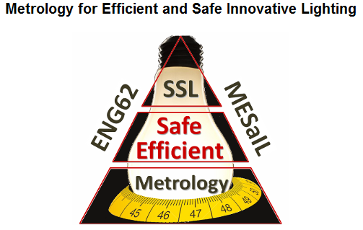

Международные сличительные испытания – проверка работы лаборатории независимыми экспертами
Независимая оценка результатов измерений и контроль качества измерений
10-го сентября 2014 был опубликован итоговый отчет международных сличительных испытаний с участием ИЦ ООО ВНИСИ. Этот отчет доступен для бесплатного скачивания на сайте IEA 4E SSL Annex
http://ssl.iea-4e.org/task-2-ssl-testing/2013-ic-final-report
В этом отчете представлены результаты измерений LED образцов в соответствии с Межлабораторным Методом Сравнительных испытаний
13
Notes:
13
There were no participants from USA (only two from Americas region) because National Voluntary Laboratory Accreditation Program (NVLAP) has already provided an accreditation programme4 for SSL testing since 2009, for which NIST provides PT, and also NIST provides PT service for SSL testing under NIST Measurement Assurance Program (MAP) for accreditation bodies other than NVLAP.
After the IC was launched, Asia Pacific Laboratory Accreditation Cooperation (APLAC) launched a similar PT program (APLAC Proficiency Test T088) conducted in 2013. This programme was operated by NLTC using the same test method (i.e., the Interlaboratory Comparison Test Method 1.0 [5]) and the same artefact types used in IC 2013. For all of these reasons, it was agreed that the results of this APLAC PT programme could be linked to IC 2013, and laboratories registering for T088 were given the option of having their results linked to IC 2013. Twenty-one laboratories chose to be linked to IC 2013

Slide 14



Примеры сотрудничества производителей и потребителей с аккредитованной лабораторией
Открытая база Light-in-Night Road – только достоверные светотехнические характеристики осветительных приборов для проектирования
Проверка качества продукции с прилавков магазинов
14
Notes:
14
There were no participants from USA (only two from Americas region) because National Voluntary Laboratory Accreditation Program (NVLAP) has already provided an accreditation programme4 for SSL testing since 2009, for which NIST provides PT, and also NIST provides PT service for SSL testing under NIST Measurement Assurance Program (MAP) for accreditation bodies other than NVLAP.
After the IC was launched, Asia Pacific Laboratory Accreditation Cooperation (APLAC) launched a similar PT program (APLAC Proficiency Test T088) conducted in 2013. This programme was operated by NLTC using the same test method (i.e., the Interlaboratory Comparison Test Method 1.0 [5]) and the same artefact types used in IC 2013. For all of these reasons, it was agreed that the results of this APLAC PT programme could be linked to IC 2013, and laboratories registering for T088 were given the option of having their results linked to IC 2013. Twenty-one laboratories chose to be linked to IC 2013

Slide 15

Спасибо за внимание!
ООО "ВНИСИ"
129626, Москва, 1-й Рижский пер., 6
Тел.: +7 (495) 788-63-11
Тел./Факс: +7 (495) 788-32-96
E-mail: vnisi@bk.ru
Web: www.vnisi.ru

